Slide 1

WordStudy
Team 21

Slide 2
Group Member
12301025 Yuwei YANG
12301041 Qi LIU
12301049 Wenbo WANG
12301056 Cong ZHANG
Team21

Slide 3
Agenda
1
Purpose/Audience
2
Description
3
User Scenarios
4
Overall Design
5
User Cases
6
Next Steps
Team21

Slide 4
Purpose
Provide non-Chinese people with a platfrom to study Chinese
Audience
All non-Chinese people especilally for people who like Chinese
Team21

Slide 5
Description
Easy to study.
  We put a strong memory algorithms to hide the product backstage, we just need to keep making a choice and don't have to care about other things.
High efficiency.
  We keep track of your training data, analyze your memories law, and then adjust the timing to reproduce your every word, so that everyone can be very efficient.
Easy to insist.
  lthough we have no right to put you into the dark room, it does make a lot of people have a similar illusion.
Team21

Slide 6

User scenarios
A foreign student studies in China. In the morning, He wants to learn some Chinese words.
Team21

Slide 7

User scenarios
After studing one list, one person wants to know how many words he has learned in this list.
Team21

Slide 8

User scenarios
before going to the bed, a student wants to test his learning situation.
Team21

Slide 9
Overall Design
Study Module
Review Module
Test Module
Team21

Slide 10

Overall Design
Study
Module
Choose list to study
Choose the list
and see the words'meaning
Diagram
2
Test
Module
Review
Module
Diagram
2
Choose the word's
meaning and compute
the right rate
Team21

Slide 11

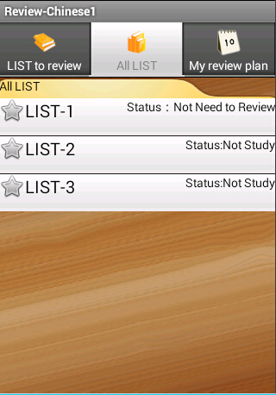
Overall Design
List--
Module:Study,review,test
ArrayList<WordList>
Team21

Slide 12
Overall Design
Fragments--
Module:About
Change between two Fragments
Team21

Slide 13
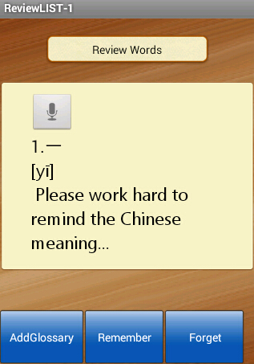
Overall Design
Localization--
Type:Three kind of languages
English
French
Italian
Team21

Slide 14
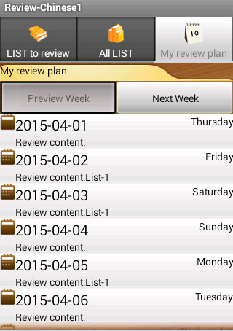
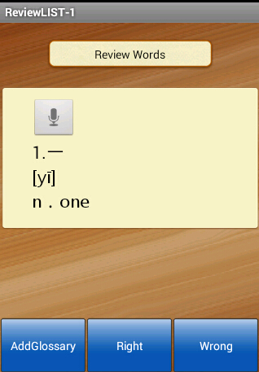
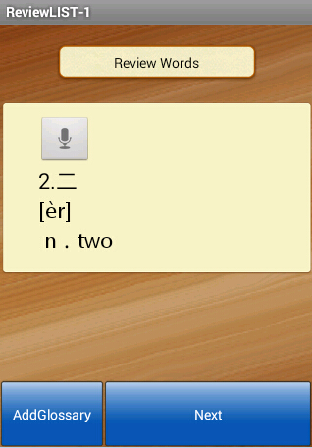
User Case
Use review module as a example
Team21

Slide 15
Next Steps
Add glossary Module
  User can add new words in the glossary.Or user can mark the words in the previous list.
Change the configuration
  Set up the time reminder. Or change the language manually.
Interaction with external
  Think about advertising and marketing strategies. Add some links to other social networking tools like facebook.
Team21

Slide 16

Thank you
TEAM21

